Slide 1


<Company> <Lesson>
Programming `Language` Workshop for Beginners
Here your text

Slide 2

<Company> <Lesson>
Table Of `Contents`
}
01
}
}
02
}
Programming
Theory Lesson
Elaborate on what you want to discuss.
Elaborate on what you want to discuss.
}
03
}
{Features Topic}
Elaborate on what you want to discuss.

Slide 3

<Company> <Lesson>
{01}
Programming`
Programming is the art of telling a computer what to do through a set of instructions written in a specific language. It is a creative and logical process that allows us to develop software, websites, apps, and much more. By mastering programming languages, individuals can create innovative solutions, automate tasks, and bring their ideas to life in the digital world. Whether you are a beginner or an experienced coder, the world of programming offers endless opportunities for learning, growth, and problem-solving. So, grab your keyboard, let your imagination soar, and dive into the exciting world of programming!

Slide 4

<Company> <Lesson>
Welcome To <Presentation>
I'm Rain, and I'll be sharing with you my beautiful ideas. Follow me at @reallygreatsite to learn more.

Slide 5



<Company> <Lesson>
Our /Company’
}
}
Languages
Elaborate on what you want to discuss.
}
}
Create a web page
Elaborate on what you want to discuss.

Slide 6
<Company> <Lesson>
Features of ‘the Topic’ {
Step 01
Step 02
Step 03
Welcome to Step 01 of your journey! This is where you lay the foundation for all that is to come. In this step, you will begin by setting clear goals and intentions for yourself. What is it that you want to achieve?
Once you have a clear vision in mind, it's time to take the first steps towards making it a reality. Break down your goals into smaller, manageable tasks that you can tackle one by one. R
Welcome to Step 01 of your journey! This is where you lay the foundation for all that is to come. In this step, you will begin by setting clear goals and intentions for yourself. What is it that you want to achieve?

Slide 7

<Company> <Lesson>
02
Theory`/ Lesson
In today's theory lesson, we will delve into the fundamental principles that underpin our understanding of the subject at hand. It is crucial to grasp these concepts as they will serve as the building blocks for more complex ideas we will explore in the future. So, let's embark on this journey of discovery together, with an open mind and a thirst for knowledge. Remember, every question you have is valid, and every insight you bring to the discussion enriches our learning experience. Let's engage in thoughtful discussions, share our perspectives, and cultivate a deeper understanding.

Slide 8

<Company> <Lesson>
Who Should `Attend}
This workshop is designed for absolute beginners with little to no prior programming experience. Whether you're a student exploring new interests, a professional looking to switch careers, or someone curious about the world of coding, this workshop is perfect for you.
}
}
Individuals’
}
}
{Students}
Individuals with little to no prior programming experience, seeking to explore the world of coding.
Students interested in acquiring essential programming skills to enhance their academic and career prospects.

Slide 9

<Company> <Lesson>
Basics` of a Programming} Language
Understanding the basics of a programming language is essential for anyone looking to delve into the world of coding. A programming language serves as a set of instructions that computers can understand and execute to perform specific tasks. These instructions can range from simple arithmetic calculations to complex algorithms that power software applications and websites.
At the core of any programming language are fundamental concepts such as variables, data types, control structures, functions, and loops. Variables are used to store data.

Slide 10


<Company> <Lesson>
Programming} Language
}
}
Variables`
Variables are placeholders for storing data values. They can hold various types of data, such as numbers, strings (text), and Boolean (true/false) values. We'll learn how to declare variables, assign values to them, and manipulate their contents
}
}
Data }`Types
Different types of data require different ways of handling and storing them. We'll cover basic data types like integers, floating-point numbers, strings, and Boolean values. Understanding data types is crucial for writing robust and efficient code.

Slide 11



<Company> <Lesson>
Gallery [Our Student`
What can you say about your projects? Share it here!

Slide 12

<Company> <Lesson>
‘Recommendation{]
Practice Regularly:
Like any skill, programming requires consistent practice to master. Set aside dedicated time each day or week to work on coding exercises, solve problems, and build projects.
Begin with simple programs and gradually increase complexity as you become more comfortable with the language. Break down larger problems into smaller, manageable tasks to avoid feeling overwhelmed.
Start Small:

Slide 13

<Company> <Lesson>
Practical }Exercise: Simple Calculator `Program
Here's a step-by-step guide to building the calculator program:
Prompt User for Input: Ask the user to enter the first number, the operator (+, -, *, or /), and the second number.
Perform Calculation: Based on the operator entered by the user, perform the corresponding arithmetic operation on the two numbers.
Display Result: Output the result of the calculation to the user.

Slide 14
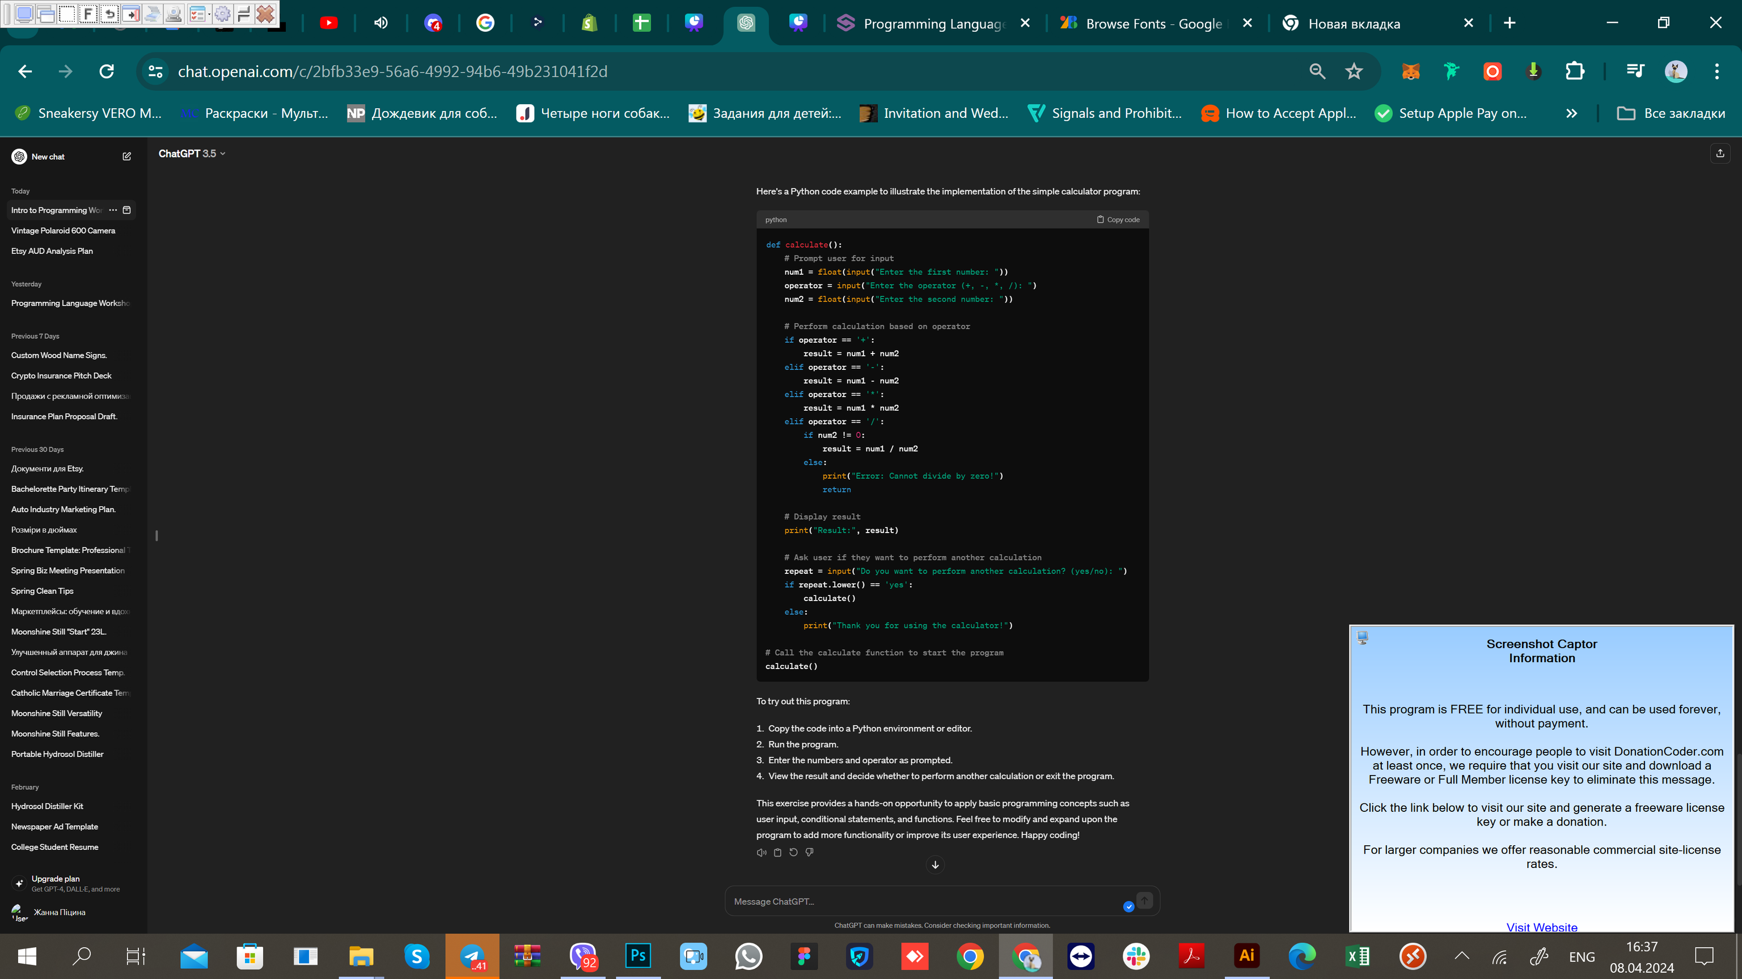
<Company> <Lesson>
Simple} Calculator `Program
To try out this program:
Copy the code into a Python environment or editor.
Run the program.
Enter the numbers and operator as prompted.
View the result and decide whether to perform another calculation or exit the program.
This exercise provides a hands-on opportunity to apply basic programming concepts such as user input, conditional statements, and functions. Feel free to modify and expand upon the program to add more functionality or improve its user experience. Happy coding!

Slide 15
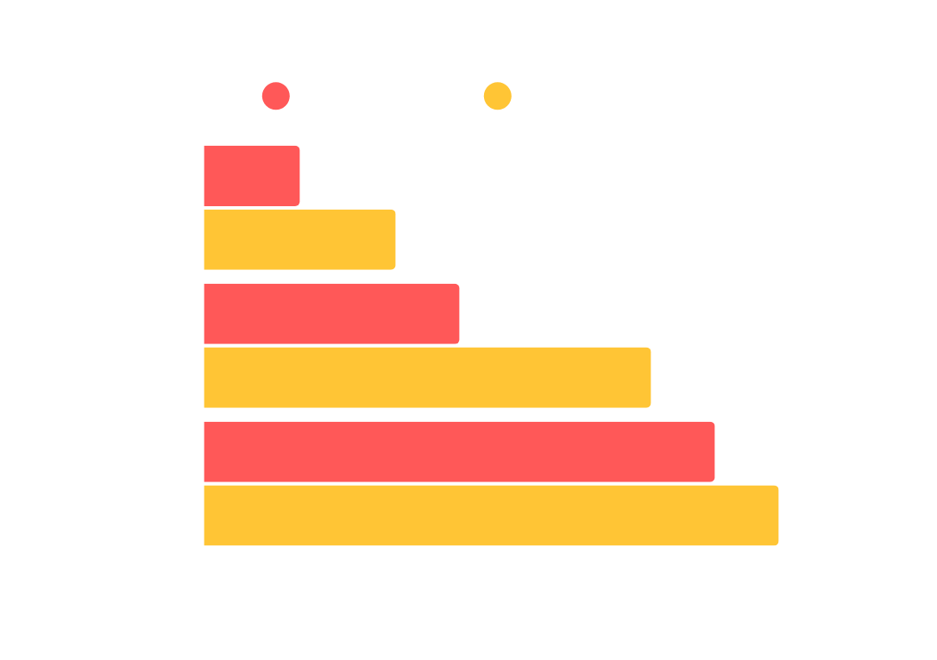
<Company> <Lesson>
Did `you know this} ?
Did you know that the Earth is the only planet in our solar system known to support life? With its perfect distance from the sun, a breathable atmosphere, and abundant water, Earth provides a unique environment for a diverse range of living organisms to thrive. The intricate web of ecosystems, from lush rainforests to vast oceans, showcases the incredible biodiversity of our planet. This delicate balance of nature highlights the importance of conservation and stewardship to ensure a sustainable future for all life on Earth.

Slide 16



<Company> <Lesson>
Testimonials`}
Client name
Client` name
Client name
Elaborate on what you want to discuss.
Elaborate on what you want to discuss.
Elaborate on what you want to discuss.

Slide 17
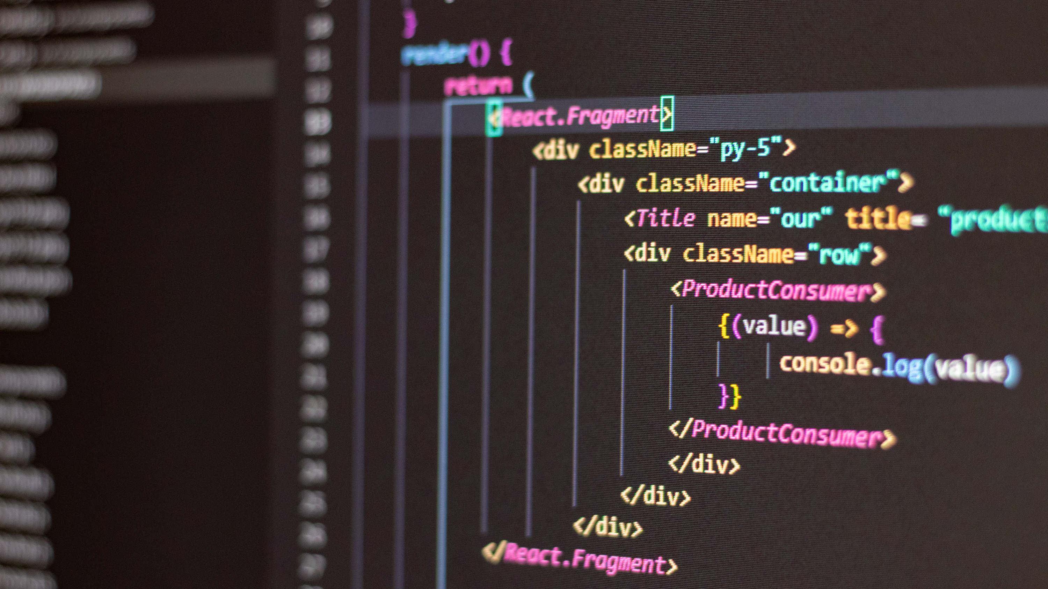
A picture is worth a thousand words

Slide 18

<Company> <Lesson>
Write an original statement or inspiring quote
— Include a credit, citation, or supporting message

Slide 19

<Company> <Lesson>
Thank You!}`
Embark on your journey into the world of programming with us! Join our workshop and take the first step towards becoming a proficient programmer. No matter your background or experience level, we're here to support you in your learning journey.
Ready to dive in? Let's start coding together!
For inquiries and registration, please contact [Your Contact Information].
[Include any logos, affiliations, or additional details as needed]
[End of Presentation]

Slide 20






Resource
Page
Use these design resources in your Canva Presentation.
You can find these fonts online too. Happy designing!
Don't forget to delete this page before presenting.
This presentation template uses the following free fonts:
Titles: Fira code
Headers: Fira code
Body Copy: Fira code

Slide 21

Credits
This presentation template is free for everyone to use thanks to the following:
SlidesCarnival for the presentation template
Pexels for the photos
Happy designing!

